Slide 1
Overview: Correlation
Correlation is used to measure the strength of linear association between two variables.

Slide 2
Overview: Regression
Regression can be used to predict or explain the value of one variable on the basis of one or more other variables.
Simple linear regression is used to explain how the values of one variable (the dependent variable, Y) are related to the values of another variable (the independent variable, X).
Simple linear regression is used to develop a mathematical equation that describes the relationship between the two variables and which can be used for prediction.

Slide 3
Example
From Field (2012)
A record company executive wants to know if record sales can be predicted from advertising expenditure.
Data is available for 200 recently released records.
X = Advertising expenditure (in thousands of pounds) in the week prior to release.
Y = Sales (in thousands) in the week after release.

Slide 4
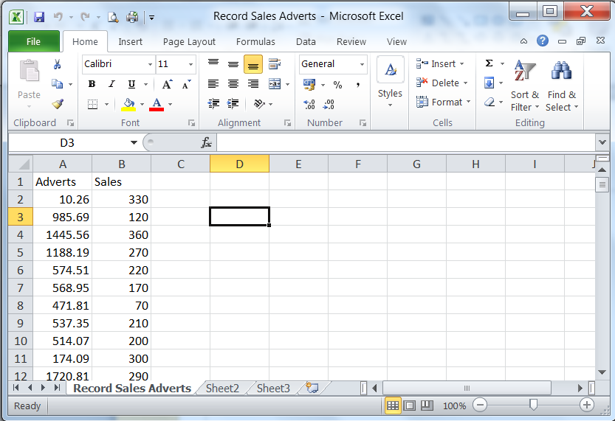
Data Input

Slide 5
Data Input
Enter the data into Excel, in two columns, as follows:
Adverts (Advertising expenditure, in thousands of pounds)
Sales (Sales after release, in thousands)
Column headings are allowed!
It should be possible to import the Excel file directly into R Studio. If not, save the file as a CSV (Comma Separated Values) file called (for example) “Record Sales Adverts.csv” and import that file.
> read.csv("Record Sales Adverts.csv") -> Record_Sales_Adverts
> attach(Record_Sales_Adverts)
…
> detach(Record_Sales_Adverts)

Slide 6
Data Input
> attach(Record_Sales_Adverts)
> Record_Sales_Adverts
Adverts Sales
1 10.26 330
2 985.69 120
3 1445.56 360
4 1188.19 270
5 574.51 220
6 568.95 170
7 471.81 70
8 537.35 210
9 514.07 200
10 174.09 300
...
> detach(Record_Sales_Adverts)

Slide 7
Data Input
> attach(Record_Sales_Adverts)
> summary(Record_Sales_Adverts)
Adverts Sales
Min. : 9.1 Min. : 10.0
1st Qu.: 215.9 1st Qu.:137.5
Median : 531.9 Median :200.0
Mean : 614.4 Mean :193.2
3rd Qu.: 911.2 3rd Qu.:250.0
Max. :2271.9 Max. :360.0
> detach(Record_Sales_Adverts)

Slide 8
Requirements
To determine the nature of the relationship between advertising expenditure and record sales.

Slide 9
Intuitive Analysis

Slide 10
Intuitive Analysis (cont.)
From the plot it can be seen that there is an approximately linear relationship between record sales and advertising expenditure.
This relationship is such that the greater the advertising budget, the higher the record sales.
The exact nature of the relationship can be approximated by putting a straight line through the data so that it captures the apparent relationship as well as is possible.

Slide 11
Intuitive Analysis (cont.)

Slide 12
Plots in R
> plot(Sales~Adverts)
> title(main="Plot of record sales (y) against advertising expenditure (x)")
> title(xlab="Adverts",col.lab="white")
> title(xlab="Advertising expenditure (£000's)")
> title(ylab="Sales",col.lab="white")
> title(ylab="Record sales (000's)")
> abline(lm(Sales~Adverts))

Slide 13
Correlation
The correlation between two variables measures the linear relationship between them.
At one extreme, a correlation of exactly 1 means that the two variables have a perfect linear relationship – a plot of the data would be exactly a straight line where as one variable increases the other also increases.
The other extreme is a correlation of –1 which is also a perfect linear relationship but where one variable decreases as the other increases.
In the middle is a correlation of exactly zero. This occurs where there is absolutely no linear relationship between the two variables.

Slide 14
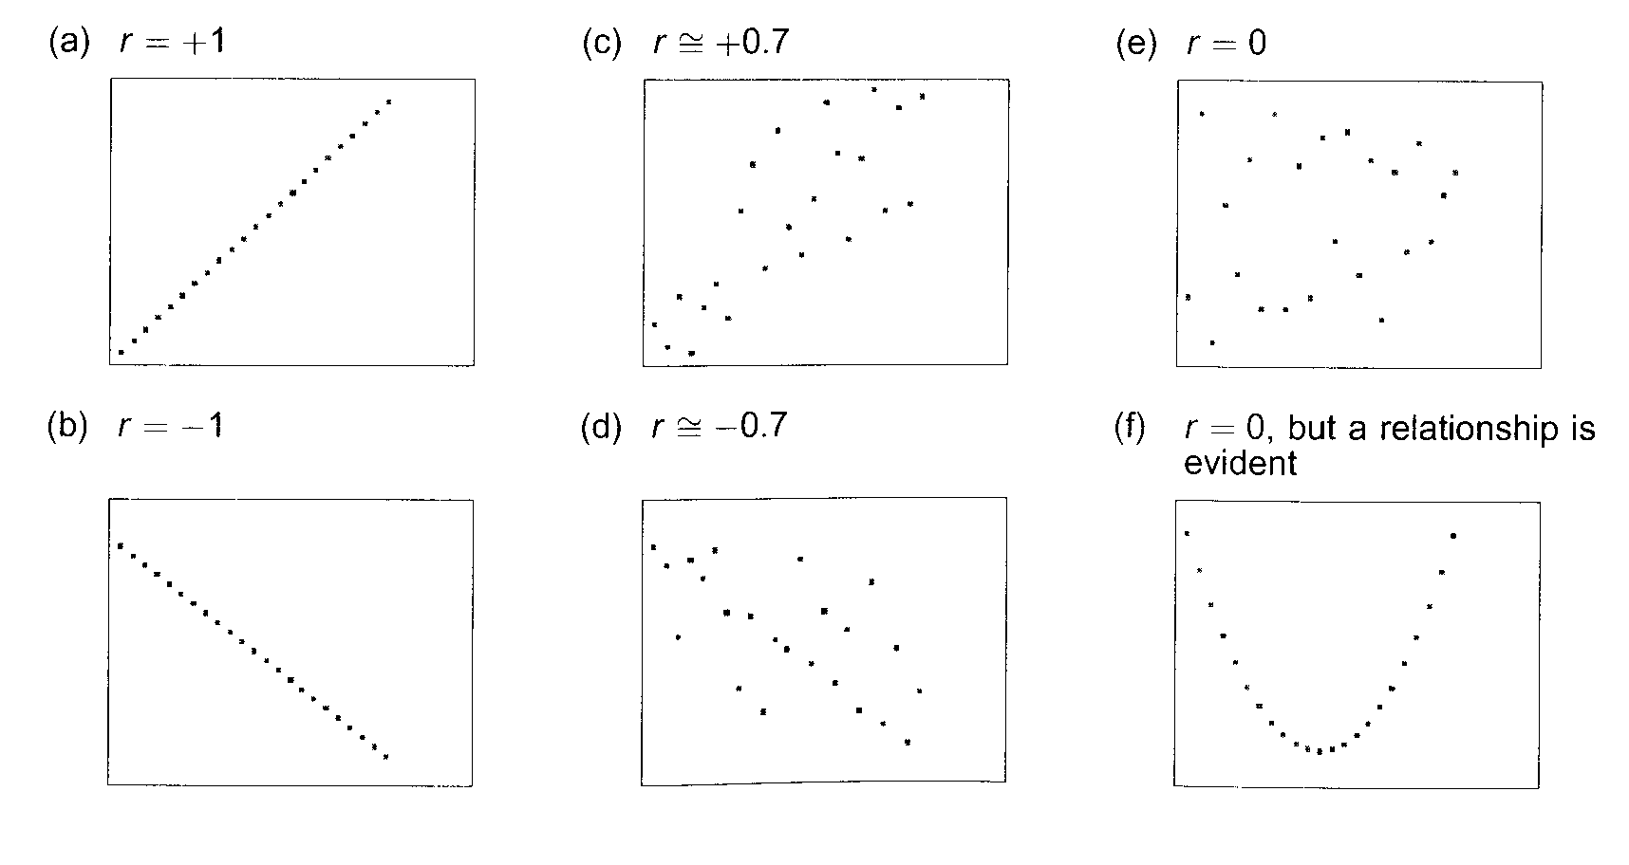
Correlation (Cont.)

Slide 15
Correlation in R
> cor.test(Adverts,Sales)
Pearson's product-moment correlation
data: Adverts and Sales
t = 9.9793, df = 198, p-value < 2.2e-16
alternative hypothesis: true correlation is not equal to 0
95 percent confidence interval:
0.4781208 0.6639410
sample estimates:
cor
0.5784878

Slide 16
Correlation in R
> cor.test(Sales,Adverts)
Pearson's product-moment correlation
data: Sales and Adverts
t = 9.9793, df = 198, p-value < 2.2e-16
alternative hypothesis: true correlation is not equal to 0
95 percent confidence interval:
0.4781208 0.6639410
sample estimates:
cor
0.5784878

Slide 17
Correlation (cont.)
The Pearson correlation coefficient (calculated for the sample data) is r = 0.578.
A hypothesis test can be carried out for the value of the correlation coefficient in the population:
H₀: correlation = 0
H₁: correlation ≠ 0
From the output, p < 0.001
We therefore have sufficient evidence to reject the null hypothesis at the 5% level of significance. There is overwhelming evidence against H₀

Slide 18
Assumptions: Correlation
For the hypothesis test of the correlation coefficient, we are assuming that the variables come from Normal distributions and are independent of each other.
We are also assuming that a linear relationship potentially exists.

Slide 19
Assumptions: Correlation (cont.)
If the assumptions are not met:
The hypothesis test should be disregarded, or...
It is possible to use a non-parametric test (e.g. Spearman’s Rho) instead of Pearson’s Product-Moment Correlation Coefficient.
Spearman’s Rho can also be used when the variables are ordinal, as it is based on a ranking system.
Note: You should always use Pearson’s r if the variables are quantitative and the assumptions are met.

Slide 20
Spearman’s Rho in R
> cor.test(Adverts,Sales,method="spearman")
Spearman's rank correlation rho
data: Adverts and Sales
S = 594411.3, p-value < 2.2e-16
alternative hypothesis: true rho is not equal to 0
sample estimates:
rho
0.5541804
Warning message:
In cor.test.default(Adverts, Sales, method = "spearman") :
Cannot compute exact p-value with ties

Slide 21
Regression
Closely linked with correlation.
Assumes a linear (ie. straight line) relationship between X and Y.
Gives an equation which describes the linear relationship between the dependent and independent variables (line of ‘best fit’).
This equation is of the form Y = β₀ + β₁X, where β₀ is a constant, known as the intercept (ie. the value of Y when X = 0), and β₁ is the slope or gradient of the line.
The equation can be used to predict the value of the dependent variable for a given value of the independent variable.

Slide 22
Regression (cont.)
The variable Y is often referred to as the dependent variable or response variable and X is often referred to as the independent variable, explanatory variable or regressor.
Here, we define record sales as the outcome/dependent/Y-variable and advertising expenditure as the explanatory/independent/X-variable.

Slide 23
Regression (cont.)
The usual way of deciding where the “best fit” line should be is to use “Least Squares”.
The line is chosen so that the sum of the squared vertical distances from the points to the line is minimised.
In other words, the “errors” (also called “residuals”), or distances from the line to the points, are squared and summed and the intercept and slope are chosen to minimise this value.

Slide 24
Regression in R
> lm(Sales~Adverts)
Call:
lm(formula = Sales ~ Adverts)
Coefficients:
(Intercept) Adverts
134.13990 0.09612

Slide 25
Regression (cont.)
We estimate the slope β₁ as = 0.09612
We estimate the intercept β₀ as = 134.13990
The equation of the regression line is therefore
Y = 134.140 + (0.096)( X)
or Sales = 134.140 + (0.096)(Adverts)

Slide 26
Regression in R (cont.)
> summary(lm(Sales~Adverts))
Call:
lm(formula = Sales ~ Adverts)
Residuals:
Min 1Q Median 3Q Max
-152.949 -43.796 -0.393 37.040 211.865
Coefficients:
Estimate Std. Error t value Pr(>|t|)
(Intercept) 1.341e+02 7.537e+00 17.799 <2e-16 ***
Adverts 9.612e-02 9.632e-03 9.979 <2e-16 ***
---
Signif. codes: 0 ‘***’ 0.001 ‘**’ 0.01 ‘*’ 0.05 ‘.’ 0.1 ‘ ’ 1
Residual standard error: 65.99 on 198 degrees of freedom
Multiple R-squared: 0.3346, Adjusted R-squared: 0.3313
F-statistic: 99.59 on 1 and 198 DF, p-value: < 2.2e-16

Slide 27
Regression in R (cont.)
> anova(lm(Sales~Adverts))
Analysis of Variance Table
Response: Sales
Df Sum Sq Mean Sq F value Pr(>F)
Adverts 1 433688 433688 99.587 < 2.2e-16 ***
Residuals 198 862264 4355
---
Signif. codes: 0 ‘***’ 0.001 ‘**’ 0.01 ‘*’ 0.05 ‘.’ 0.1 ‘ ’ 1
N.B. The key statistics from the Analysis of Variance (ANOVA) are also contained in the summary output (see previous slide).

Slide 28
Regression (cont.)
If there were no real linear relationship between the two variables, then the line would be a horizontal line through the data and the slope would be zero.
Thus, if we want to test whether or not this regression line is showing a real linear relationship, we can test the following hypotheses:
H₀: slope = 0
H₁: slope ≠ 0

Slide 29
Regression (cont.)
This can be done in two ways in simple linear regression:
One way is through the “Analysis of Variance” table (ANOVA).
The second way is to directly do a t-test on the slope coefficient itself.
It is also possible to do a t-test on the intercept coefficient.

Slide 30
Regression (cont.)
The equation of the regression line is Sales = 134.140 + (0.096)(Adverts)
The p-value for the ANOVA is less than 0.05 (p < 0.001) so we conclude that there is a significant relationship between record sales and advertising expenditure.
The p-values for the coefficients (slope and intercept) are both less than 0.05 (p < 0.001 in both cases) so we conclude that the coefficients are significantly different from zero.

Slide 31
Regression (cont.)
From the detailed model summary, we can also get a measure of how well the straight line fits the data (how strong a linear relationship exists).
The “coefficient of determination”, also known as (Multiple) R², ranges from 0 (0%) to 1 (100%).
For this example, R² = 0.3346 or 33.46%.
This means that 33.5% (i.e. about a third) of the variability in record sales (Y) can be explained by advertising expenditure (X).

Slide 32
Regression (cont.)
R Squared = R² = Coefficient of determination (calculated for sample values)
33.5% of the variability in record sales can be explained by advertising expenditure, for this sample of 200 records.
Adjusted R² = Estimate of R² for population from which sample values were obtained.
33.1% of the variability in record sales can be explained by advertising expenditure, in the population.

Slide 33
Regression (cont.)
If R² is over 90% then the fit of the straight line to the data is remarkably good. If it is between 80% and 90% then it is a good fit. 60% to 80% indicates a reasonable fit and below 60% the fit is not too good, depending on the context.
In simple linear regression, R² is equal to the square of the correlation coefficient, r.

Slide 34
Fitted Line Plot

Slide 35
Results
The equation of the line of best fit is (Sales) = 134.140 + (0.096)(Adverts)
The coefficient of Adverts (i.e. the slope) is significant at the 5% level, which leads us to conclude that there is a significant relationship between record sales and advertising expenditure.
R² = 33.5% means that about a third of the variability in record sales can be explained by advertising expenditure.

Slide 36
Assumptions: Regression
For the hypothesis tests (the ANOVA or the t-tests of coefficients) in regression, we must assume that the errors in the fit of the model (i.e. the residuals) come from a Normal distribution with constant variance and are independent of each other.
We are also assuming that a linear relationship potentially exists.
There are ways of assessing whether or not these assumptions are reasonable.

Slide 37
Assumptions: Regression (cont.)
If the assumptions are not met:
The hypothesis tests should be disregarded.
It is sometimes possible to carry out transformations of the data so that a linear relationship, constant variance and Normality result.

Slide 38
Examining the Data
It is important to examine the data on a scatterplot first.
Is there a relationship between X and Y?
Is the relationship between X and Y linear? (If not, it may be possible to make it linear by transforming one or both variables)
Are there any outliers or influential values which may affect the results? (If so, they should be examined and consideration given to investigating the effect of removing the outliers upon the analysis).
Is there anything else going on (eg. a different pattern for males than for females, or a restricted range of X values)?

Slide 39
Points to Note (1)
The correlation between X and Y is the same as the correlation between Y and X.
The equation of the regression of Y on X (used to predict Y) is not the same as the equation of the regression of X on Y (used to predict X).
Correlation and regression can be used as descriptive techniques, in which case the assumptions are not important.
The assumptions for correlation and regression are only important if you wish to carry out statistical inference (hypothesis tests and confidence intervals).

Slide 40
Points to Note (2)
It is dangerous to use the regression equation for prediction using values of X outside of the range of observed values of X.
The value of the intercept, β₀, may not be meaningful if X = 0 is not meaningful, or if X = 0 is outside the range of values of X used to obtain the equation.
Use of correlation and regression techniques does not enable us to say anything about cause and effect.

Slide 41
Making Predictions
Providing the relationship between record sales and advertising expenditure is linear, and the assumptions are justified, we can now use the regression equation to make predictions and/or marketing adjustments.

Slide 42
Prediction
Based on the equation obtained from a sample of 200 records, if the record company executive is prepared to spend £100,000 on advertising a new record (ie. X = 100), what record sales (Y) would you predict in the first week after the record’s release?
Y = 134.140 + 0.096 X
= 134.140 + (0.096)(100)
= 143.740
Therefore the predicted value of Y (when X = 100) is 143.740. This represents predicted sales of 143,740.

Slide 43
Prediction (cont.)
The predicted value number of record sales (when X = 100) was 143,740.
In the sample of 200, there was a record for which X = 100.03. Corresponding sales for this record were 140,000. This is less than predicted.
The predicted value of Y does not necessarily correspond to an actual observation of Y.

Slide 44
Prediction in R
> predict(lm(Sales~Adverts), list(Adverts=100))
1
143.7523
N.B. The predicted value obtained using R is not exactly the same as that obtained by hand. This is due to rounding (by hand).

Slide 45
Choosing between 2 models
DV: Record Sales
IV1: Advertising Expenditure
IV2: Attractiveness of Band
In the lecture:
Record Sales = 134.140 + (0.096)(Advertising Expenditure)
In the practical:
Record Sales = 65.510 + (18.861)(Attractiveness)
Which of these two models is “best”?
What is meant by “best”?

Slide 46
How to Decide Which Model is “Best”?
Suggestions:
Check that assumptions are satisfied (for model to be valid).
Compare fitted line plots.
Consider the values of r, R² and Adjusted R².
Check significance the regression model (ANOVA output).
Check significance of the slope (t-test).

Slide 47
Record Sales Examples

Slide 48
Record Sales Examples
IV = Adverts IV = Attract
R² 0.335 0.106
Adj.R² 0.331 0.102
r 0.578 (p<0.001) 0.326 (p<0.001)
t 9.979 (p<0.001) 4.854 (p<0.001)
F 99.587 (p<0.001) 23.563 (p<0.001)
Which model do you think is best?

Slide 49
Introduction to Multiple Regression
Can we include both IVs in a single model?
Yes – using multiple regression.
(Simple) Linear Regression Model:
Y = β₀ + β₁X
Multiple (Linear) Regression Model:
Y = β₀ + β₁X₁ + β₂X₂

Slide 50
Introduction to Multiple Regression (cont.)
> read.csv("Record Sales Adverts + Attract.csv") -> Record_Sales_Both
> attach(Record_Sales_Both)
> Record_Sales_Both
Sales Advertising Attractiveness
1 330 10.26 10
2 120 985.69 7
3 360 1445.56 7
4 270 1188.19 7
5 220 574.51 5
6 170 568.95 5
7 70 471.81 1
8 210 537.35 9
9 200 514.07 7
10 300 174.09 7
…

Slide 51
Introduction to Multiple Regression (cont.)
> lm(Sales~Advertising+Attractiveness)
Call:
lm(formula = Sales ~ Advertising + Attractiveness)
Coefficients:
(Intercept) Advertising Attractiveness
26.34115 0.09235 16.26548
The regression equation is:
Sales = 26.341 + (0.092)(Advertising) + (16.265)(Attractiveness)

Slide 52
Introduction to Multiple Regression (cont.)
> summary(lm(Sales~Advertising+Attractiveness))
Call:
lm(formula = Sales ~ Advertising + Attractiveness)
Residuals:
Min 1Q Median 3Q Max
-135.29 -37.16 0.72 34.44 190.09
Coefficients:
Estimate Std. Error t value Pr(>|t|)
(Intercept) 26.341153 22.155112 1.189 0.236
Advertising 0.092351 0.009098 10.150 < 2e-16 ***
Attractiveness 16.265478 3.166849 5.136 6.71e-07 ***
---
Signif. codes: 0 ‘***’ 0.001 ‘**’ 0.01 ‘*’ 0.05 ‘.’ 0.1 ‘ ’ 1
Residual standard error: 62.13 on 197 degrees of freedom
Multiple R-squared: 0.4132, Adjusted R-squared: 0.4073
F-statistic: 69.37 on 2 and 197 DF, p-value: < 2.2e-16

Slide 53
Model Summary
The regression equation is:
Sales = 26.341 + (0.092)(Advertising) + (16.265)(Attractiveness)
The R² value is 0.413 (41.3%)
More on Multiple Regression next time!

